Slide 1
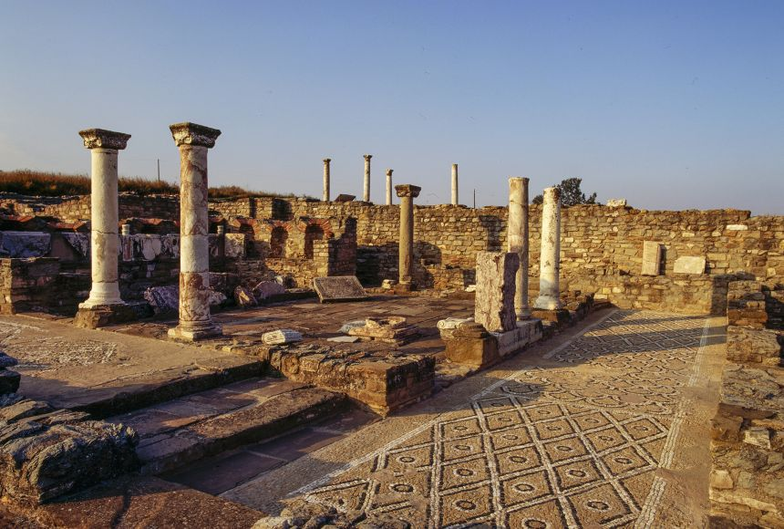
Philip II of Macedon
Goal/s:
Describe the life and achievements of Philip II
Week 9 Lesson 1 – unit 2
Ms Barrie

Slide 2
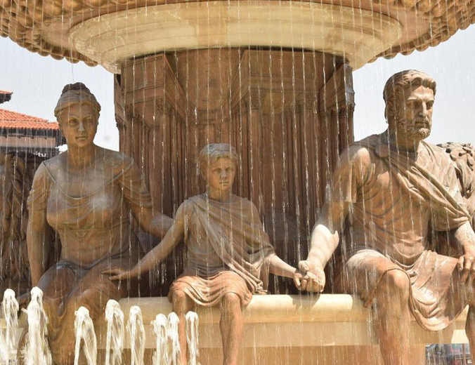

Philip II of Macedon
King Philip II of Macedon was one of the most influential and impressive rulers in ancient history.
He was a skilled diplomat, warrior, and strategist, and he led his country to great military and political successes.

Slide 3
ACTIVITY 1 – Comprehension Sheet
Read the information about Philip II of Macedon on the following slides.
Summarise in the appropriate area on your comprehension sheet.

Slide 4
Background Information
Macedon was a small kingdom located to the north of Greece, and it had been in a state of conflict with its western neighbor, Illyria, for many years. The Macedonian royal family was called the Argeads, who claimed descent from the mythical figure of and Hercules.
Philip II was born around 382 BC and was the third son of the Macedon king Amyntas III. Following the assassination of his eldest brother in 367 BC, Philip was sent as a political hostage to the Greek city-state of Thebes at about the age of 16.
His three-year period provided him with relative freedom to explore Thebes and observe their military tactics. Philip also learnt military and diplomatic tactics from famous Theban general, Epaminondas. He would draw upon this information later on when Philip sought to reorganise Macedon's military structures.

Slide 5
Philip becomes King
Philip returned to Macedon in 364 BC. Then, in 359 BC, Philip's brother, King Perdiccas III, was killed in battle against the Illyrians. Perdiccas had appointed Philip as the regent for his you son Amyntas IV, but after his brother's death, Philip II took the Macedonian throne for himself He was aged around 23 years old at the time. Once secure in his power, Philip turned his attention to his main concern, was to increase Macedonia's military strength.
Philip overhauled his army and developed, what has become known as, the Macedonian phalanx. Specifically, he increased the number of men in each phalanx unit. The expansion of the army over this time increased its overall size from 10,000 to 24,000 and expanded the cavalry from 600 to 3,500. Now it was no longer an army of free citizens; instead, it was one composed of professional soldiers.
Philip armed his new soldiers with longer spears, called the sarissa. This new spear type was around six metres long, which meant that it reached much further than the traditional hoplite spears used by the other Greek city-states.
This new formation was extremely effective, and it helped Philip to win a series of military victories against Illyria, Athens, and Thebes.
Next, Philip established a new capital city for Macedon, at the site of Pella. He also built a new royal palace and made plans for a grand tomb, which were both completed after his death. To increase the prestige of his new city, Philip invited the best poets, writers, and philosophers from the Greek world to visit and work there. Most famously, the philosopher Aristotle was hired to teach Philip's son, Alexander.

Slide 6
Campaigns against Greeks
In 358 BC, Philip became involved in a conflict with Athens over the city of Amphipolis. In the same year, Philip captured was able to capture the city, and took control of its gold and silver mines. Then, in 357 BC, Philip conquered the northern Greek cities of Pydna in 357 BC and Potidaea in 356 BC.
This led to the Third Sacred War, which was fought between Amphictyonic League of northern Greek city states and the Phocians, who had seized control of the Delphic Oracle. The Amphictyonic League, which was led by the city of Thebes, had asked Philip to assist their attacks, while the Phocians had asked Athens to be their ally. After a series of battles, where both sides suffered defeated, the various city-states were nearing exhaustion and the war ended in 346 BC. By the war's end, Philip had significantly expanded his control over northern Greece, and he had become the most powerful man in Greece.
However, a series of battles had taken a physical toll on Philip. He had lost one of his eyes, broken a shoulder, and was crippled in one leg.

Slide 7
Battle of Chaeronea
The speed and effectiveness with which Philip had risen to power scared and worried the other Greek city-states. In Athens, a famous politician, called Demosthenes, began to give a series of speeches calling for the Greeks to unite and stop Philip.
In 339 BC, Athens, along with Thebes and several other city-states formed an alliance against Macedon. The following year, the two armies met at Chaeronea in Boeotia. The battle was fought on a hot day in August. Despite being outnumbered by around 20%, the Macedonian phalanx prevailed against their opponents.
Philp's son, Alexander (who would later become Alexander the Great), played a key role in the victory. After the battle, all of Greece was effectively under Philip's control. This victory solidified Macedon's position as the leading power in Greece.
In 337 BC, at the PanHellenic Congress that followed the battle, Philip was declared the leader of all Greece. He was given the title of "Hegemon", meaning "leader" of an alliance called the League of Corinth. In return for his leadership, Philip promised to lead a joint Greek expedition to invade and conquer Persia.

Slide 8
Marriages and Family
In 357 BC, Philip married Olympias, a princess of Epirus. This was an important diplomatic marriage, as it allied Macedon with Epirus. Olympias was a strong and politically astute woman, who is said to have exerted a great deal of influence over her husband. However, this also made her a very controversial figure, and she earned a reputation for being ruthless and ambitious.
The couple had four children together: Alexander (who would later become Alexander the Great), Cleopatra, James, and Philip.
In 337 BC, after the Battle of Chaeronea, Philip married Cleopatra Eurydice. However, the new marriage caused tension between Philip, Olympias and Alexander. At the wedding celebration, Alexander became angry at his father's embarrassing drunkenness and publicly voiced his frustrations. Because of his remarks, he and his mother were both exiled from Macedon for a short time: she in Epirus and he in Illyria.

Slide 9
Death
After his victory at Chaeronea, Philip turned his attention to a potential invasion of Persia, which he saw as the next major threat to Macedon. However, in 336 BC, was assassinated by one of his bodyguards, Pausanias, before he could launch his invasion. Philip was 46 years old when he died.
His son Alexander succeeded him as king and went on to become one of the most famous rulers in history. Alexander would use Philip's military developments in order to carry out the planned invasion of Persia.
During his lifetime, Philip transformed Macedon from a small kingdom on the fringe of the Greek world into the most powerful state in Greece. He left a lasting legacy as one of the most successful kings of Macedon. He was a skilled military leader and strategist, and he helped to expand Macedon's territory and influence. He also laid the foundations for Alexander's later conquests by uniting the Greek city-states under Macedonian rule. Philip II was truly one of the greatest rulers of his time.

Slide 10
ACTIVITY 2 - Video
https://www.youtube.com/watch?v=yVTrkESkuTw&ab_channel=KingsandGenerals
Watch the following video.
Record any key dates/events in your book:
DATE | EVENT

Slide 11
SUMMARY
Based upon what you have learnt in the video, answer the question below in paragraph format (Topic Sentence, Explanation, Evidence, Linking Sentence):
How did Philip turn Macedon into the most powerful Greek kingdom?

